Slide 1
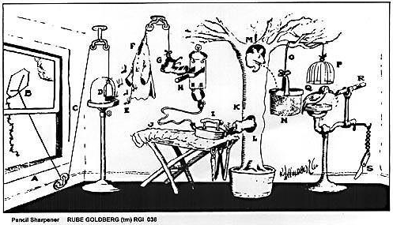
CAUSE and EFFECT
How to Sharpen a Pencil

Slide 2
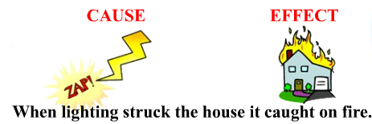
Cause and Effect – the relationship between two things.

Slide 3
Signal Words
Questions
Cause
  Because of
  Caused by
  Created by
  Since
  The reason for
  On account of
  Due to
  Led to
Effect
  As a result
  Consequently
  Hence
  Since
  So
  Therefore
  Finally
  For this reason
  Then
  Effect
What event happened?
Did this event cause another event to happen?
Did the event cause several other events to happen?

Slide 4
Identify Cause and Effect
E
C
Since I dropped my fork, I had to get a new one.
People choose to stop at the mall due to the number of stores located close together.
She had lots of free time, consequently she spent the day reading a book.
I slammed my finger in the car door so I had to go to the hospital and get an x-ray.
The team fumbled the ball numerous times, for this reason they lost the game.
E
C
C
E
E
C
C
E

Slide 5
It’s Not Always Easy to Separate Cause and Effect
The difference between cause and effect may seem clear, but it's not always easy to separate the two.
For one thing, the two work very closely together.
For another, effects often become causes for other events.
http://www.education.com/reference/article/effect1/

Slide 6
Here's an example.
Imagine that you lost your house keys. As a result, you might have to stay in the school library until one of your parents can pick you up. Getting stuck in the library provides two hours of uninterrupted time to get started on your research paper assignment. Therefore, you can go to the baseball game this weekend instead of doing research.
A caused B, B caused C, and C caused D.
Lost house keys
Stays in library
Start research paper
Go to baseball game

Slide 7
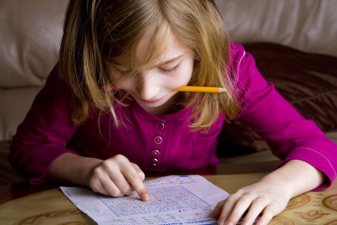
One Effect Has Several Causes
Cause
Cause
The girl studied every night and got help from her tutor so she did well on the test.
Effect

Slide 8
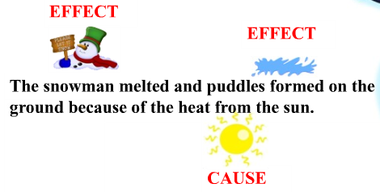
One Cause Has Several Effects

Slide 9
Write Your Own
3 causes
Gets too little sleep
1 effect
Does not eat breakfast
Low grades
Does not do homework

Slide 10
Write Your Own
3 effects
Hit a telephone pole
1 cause
The pole fell on a building
The car slid on a patch of ice
The building roof collapsed

Slide 11
One Cause and Several Effects
In 1773, England taxed the tea sold to American colonies. The Colonists got angry at the King of England. In the Boston Tea Party, colonists dressed as Indians dumped tea into the Boston Harbor. The colonies moved closer to rebellion.
Causes | Effects
England taxed tea
Colonists get angry
Tea dumped in harbor
Moved closer to rebellion

Slide 12
Cause and Several Effects
Cause | Effect
When a blood vessel in the skin is cut some blood leaks out. However, soon platelets clump together at the injury. The platelets give off a substance that causes a tangle of fibers to form. The clot seals the break in the blood vessel. The bleeding stops.
Blood vessel is cut.
Blood leaks out
Blood leaks out
Platelets clump together
Platelets clump together
Tangle of fibers forms
Tangle of fibers forms
Clot seals the break
Clot seals the break
Bleeding stops

Slide 13
Another Practice
Cause | Effect
America obtained land west of the Mississippi River when Napoleon sold the Louisiana Territory to America. Due to this, Lewis and Clark opened a trail to the west coast and New Orleans passed from French to American rule. America expanded further and further west.
Napoleon sells Louisiana Territory
Our nation has land west of Mississippi
Lewis and Clark
open trails to west
New Orleans falls
under American rule
America expanded

Slide 14
Chain of Events
In recent decades, cities have grown so large that now about 50% of the Earth's population lives in urban areas. There are several reasons for this occurrence. First, the increasing industrialization of the nineteenth century resulted in the creation of many factory jobs, which tended to be located in cities. These jobs, with their promise of a better material life, attracted many people from rural areas. Second, there were many schools established to educate the children of the new factory laborers. The promise of a better education persuaded many families to leave farming communities and move to the cities. Finally, as the cities grew, people established places of leisure, entertainment, and culture, such as sports stadiums, theaters, and museums. For many people, these facilities made city life appear more interesting than life on the farm, and therefore drew them away from rural communities.
Signal Words

Slide 15
Cause and Effect
Cause | Effect
Factory jobs in cities
Better schools in the cities
50% of the earth’s population lives in urban areas
Superior leisure locations

